Slide 1
Amrita Vishwa Vidyapeetham, Amaravati Campus
22AIE214 Introduction to AI Robotics
To Develop Path Planning and Obstacle Avoidance for a Robotic Arm Mounted on a Quadrotor UAV
by B.Yashwanthkumar

Slide 2
Introduction
This project addresses the critical challenge of autonomous navigation and manipulation in complex environments using a quadrotor UAV equipped with a robotic arm. By integrating path planning, obstacle avoidance, and object manipulation capabilities, the system enables precise interaction with the environment while maintaining safety.
This technology transforms how we use drones in our daily lives - from delivering packages to your doorstep while navigating around buildings and trees, to rescuing victims during disasters, disposing explosive bombs and fruit harvesting.
The project's importance lies in its advancement of UAV capabilities beyond just flying from point A to B - it teaches them to think on their own, navigate around both stationary objects and moving people or vehicles, while actually picking up and delivering the items. This represents a significant step toward fully autonomous aerial robotic systems that can operate safely in unpredictable real-world environments, extending the application domain of UAVs from passive observation to active interaction.

Slide 3
Problem Statement, Objectives and Programming Language
Problem Statement: To develop an autonomous system for a quadrotor UAV with a mounted robotic arm that can navigate through environments with both static and dynamic obstacles while performing pick-and-place operations, using advanced path planning and obstacle avoidance algorithms.
Objectives: The Key objectives include creating a realistic 3D simulation environment, designing a functional robotic arm with grasping capabilities, implementing A* path planning for static obstacle avoidance, developing tracking systems for dynamic obstacles, establishing complete pick-and-place operations, and providing comprehensive visualization tools to analyze the UAV's performance.
Programming Language: Python
Tools: Vpython, Numpy, Matplotlib, mplot3d toolkit, math, heapq

Slide 4
Methodology
The project adopts a modular-based methodology for developing the UAV's path planning and obstacle avoidance capabilities. This approach consists of several key steps:
Environment Setup & UAV Construction: Create a virtual 3D environment with static and dynamic obstacles, and build a quadrotor UAV model with four propellers and a three-fingered gripper.
Spatial Representation & Path Planning: Implement an occupancy grid and develop the A* algorithm for optimal path finding around static obstacles.
Dynamic Obstacle Management: Create a system for continuous tracking and avoidance of moving obstacles through real-time position updates.
Manipulation: Design precise sequences for arm extension, object grasping, and retraction to enable reliable pick-and-place operations.
Navigation Sequence: Implement a complete workflow that includes moving to pickup point, grasping objects, navigating to dropoff locations, and releasing objects.
Performance Analysis & Visualization: Generate comprehensive path data and visual representations to analyze the UAV's decision-making and movement patterns.

Slide 5
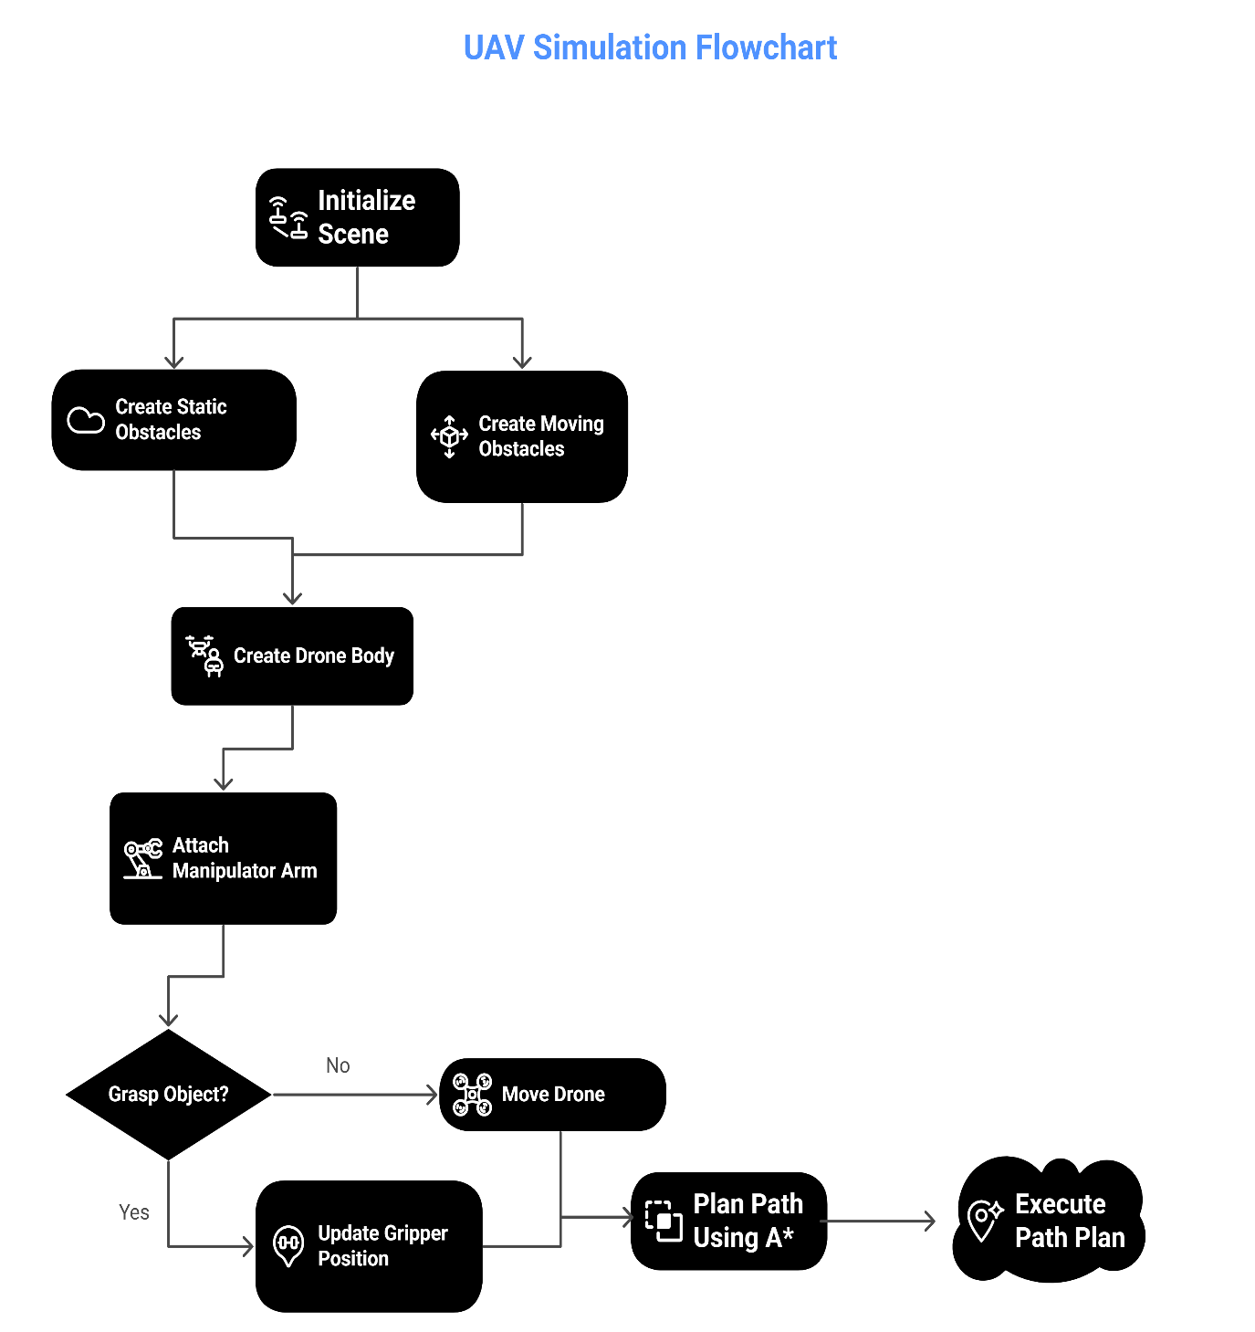
Flow-chart

Slide 6
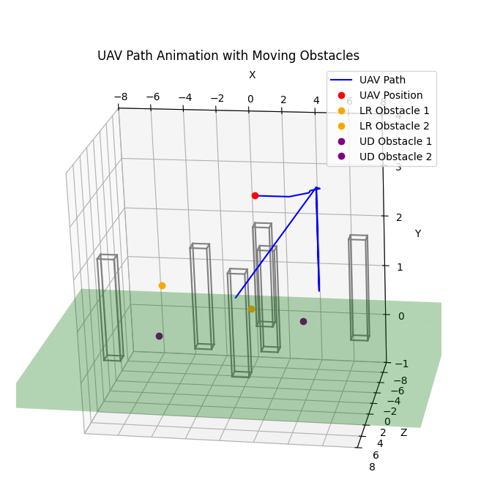
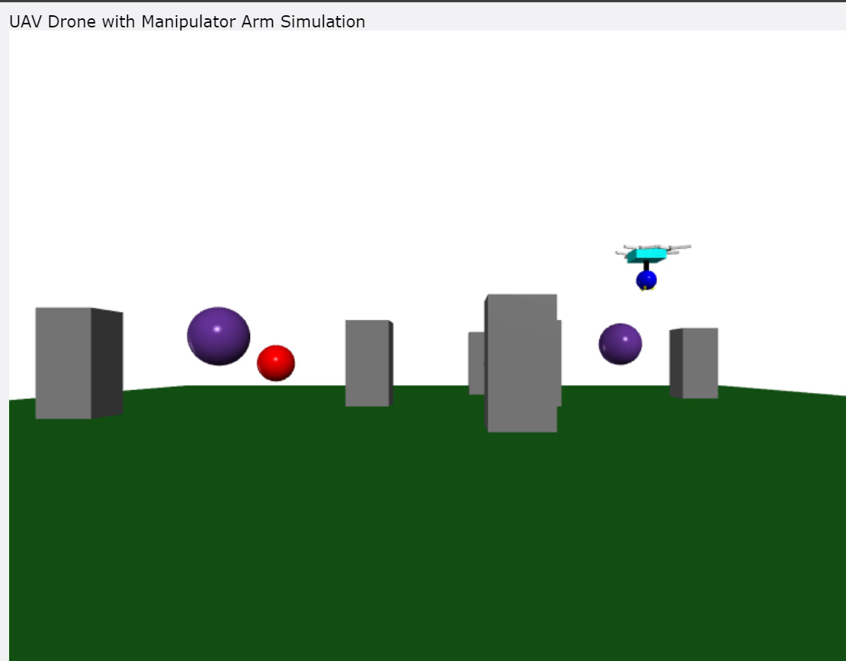
Simulation Result

Slide 7
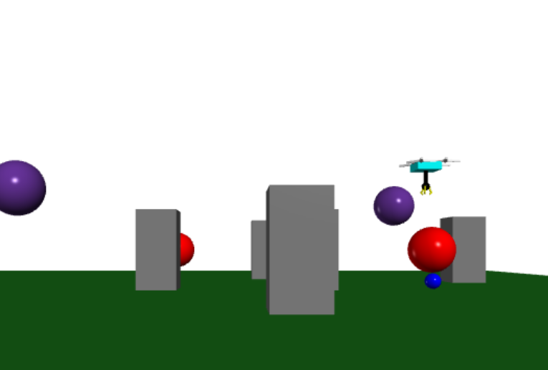
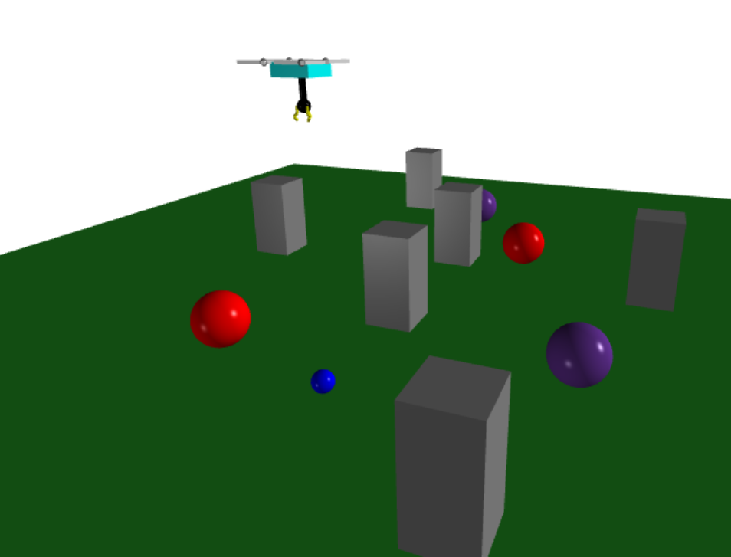
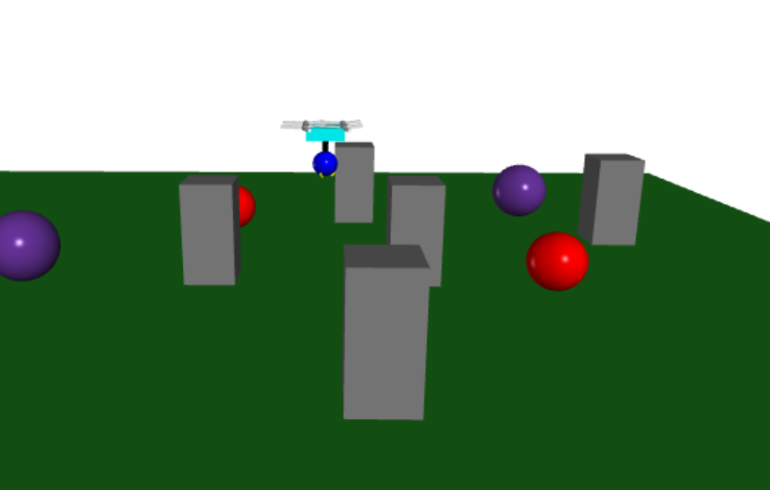
Conclusion
The project successfully implemented an autonomous UAV system with robotic arm capabilities, demonstrating effective path planning and obstacle avoidance using A* algorithm and continuous position tracking of dynamic obstacles.
Initial Position Middle Position Final Position

Slide 8
Thank You

